Slide 1
Roman Wide-Field Instrument
Reference Information
January 25, 2021
Information here pertains to the design early in Phase C

Slide 2
Wide-Field Instrument Overview
Large imaging field of view (FOV) (0.8° x 0.4°)
Spatial sampling: 0.11 arcsec/pixel; 288 Mpix focal plane
Image stability: 1.0 nm RMS wave front error (WFE) variation in 180 sec
Visible and Near-infrared (NIR) pass band (0.48 to 2.3μm)
8 imaging filters
blank position for dark current, flat-field, and other calibrations w/internal light source
Grating+prism (grism) for multi-object spectroscopy at medium spectral resolution
Prism, lower-dispersion, for multi-object spectroscopy
Guide star sensing interleaved with science data collection

Slide 3
WFI Filters and dispersers
Element name | Min (μm) | Max (μm) | Center (μm) | Width (μm) | R
F062 | 0.48 | 0.76 | 0.620 | 0.280 | 2.2
F087 | 0.76 | 0.977 | 0.869 | 0.217 | 4
F106 | 0.927 | 1.192 | 1.060 | 0.265 | 4
F129 | 1.131 | 1.454 | 1.293 | 0.323 | 4
F158 | 1.380 | 1.774 | 1.577 | 0.394 | 4
F184 | 1.683 | 2.000 | 1.842 | 0.317 | 5.81
F213 | 1.95 | 2.30 | 2.125 | 0.35 | 6.07
F146 | 0.927 | 2.000 | 1.464 | 1.030 | 1.42
G150 | 1.0 | 1.93 | 1.465 | 0.930 | 461λ(2pix)
P127 | 0.75 | 1.80 | 1.275 | 1.05 | 80-180 (2pix)

Slide 4
Effective area

Slide 5
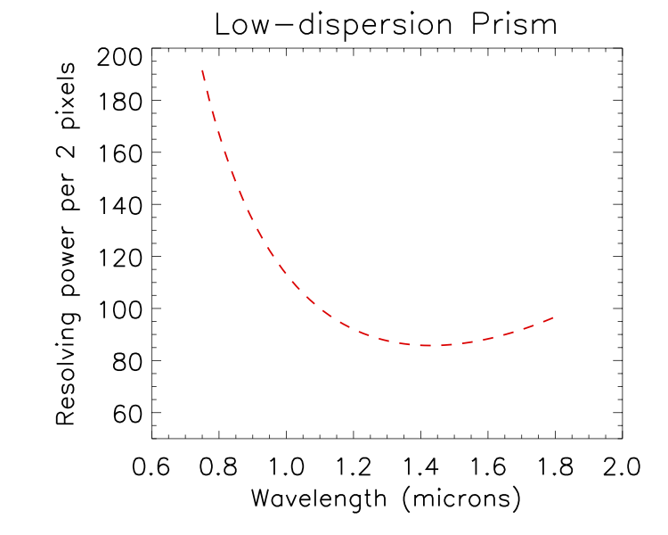
Low-dispersion prism
The prism provides higher throughput and lower dispersion than the grism.
The figure shows the resolving power per two pixels
  The FWHM of the LSF is ~2 pixels from 0.8-1.1μm and increases to ~3 pixels at either end of the spectrum.
Unlike the grism, which has constant dispersion and linearly increasing resolving power, the prism dispersion will vary with wavelength. The plot shows the dispersion at the center of the field, it varies slightly with field angle.

Slide 6
NIR detector characteristics
Representative values for flight candidate HgCdTe H4RG-10 detectors
Quantity | Spec. Value | Units | Typical actual
Dark Current | <0.1 | e-/sec/pixel | <0.005
CDS Read Noise | <20 | e- RMS | 15-16
Total Noise in 180s |  | e- RMS | 5-6
Quantum Efficiency | >80% | (avg 0.8-2.1μm) | ~95%
Quantum Efficiency | >60% | (avg 0.6-0.8μm) | 75-80%
Pixel operability | >95% | N/A | >99%
Total crosstalk | <12% | N/A | <8%
CDS noise is the RMS noise from the difference of two successive detector readouts
Total noise is uncertainty on slope fit for an exposure time of 180 sec
For more information on Roman detectors, see Mosby et al. 2020
https://doi.org/10.1117/1.JATIS.6.4.046001

Slide 7
NIR Detectors – inter-pixel capacitance
Inter-pixel capacitance
  Parasitic capacitance redistributes signal among neighboring pixels
  Total flux is conserved, but:
    correlates signal among pixels
    Signal distribution is centered on pixel, not center of light
  Useful references:
    Moore et al 2006 Optical Engineering 45 076402
    Fox et al 2009 PASP 121 743
    Kannawadi et al 2016 PASP 128 095001
Results from sample of flight candidate detectors
Charge of 100 deposited in central pixel gives:
0.20 | 1.90 | 0.21
1.84 | 91.19 | 1.82
0.22 | 1.98 | 0.22
Note that effect is not symmetric.
Individual detectors may exhibit greater asymmetry.

Slide 8
NIR Detector Information - Persistence
Persistence in Roman H4RG qualitatively similar to that in WFC3-IR detector
Long et al 2013 found the following empirical description for the persistence signal:
ISR 2013-07: Characterizing Persistence in the WFC3 IR Channel: Observations of Omega Cen
http://www.stsci.edu/hst/wfc3/ins_performance/persistence/

Slide 9
NIR Detector Information - Persistence
Persistence characteristics of the first 9 flight candidate detectors are plotted; all fall well below the requirement. The 6 flight SCAs received since this plot was made are similar.
WFC3-IR parameters from Long et al. (2013). The WFC3-IR persistence is 3.0-3.4 on this plot for prior signals > 1.x10⁵ e-/pix

Slide 10
WFI multi-accum detector readout
One of 18 parallel WF FPA detectors shown
SCA reads are non-destructive (Read Only) after an initial stable Reset/Read
Multi-Accum parameters are set based on Survey and Downlink requirements
Multi-Accum commandable parameters: (sample settings shown in graphic)
  M = # of frames averaged per resultant frame (black up-arrows)
  N = # of resultant frames sent to ICDH (blue up-arrows; lossless compression in FPE)
  D = # of read frames dropped between resultant frames
Integrated Signal on an SCA
= Resultant Frames (N = 3) – Losslessly Compressed in FPE
= Read Frames per Resultant Frame (M = 4)
= Dropped Read Frames (D = 5)
SCA Reset/Read for first frame when pointing is stable
SCA
Reset/Reads are continuous during the Slew / Acquire / Settle process
Time
Integration Time
Observation Time

Slide 11
WFI Multi-Accum Cont.
The periodic multi-accum sequence on the previous slide is an example. The actual implementation is table-driven, with the table specifying the operation to perform on each readout in the exposure. This enables logarithmic spacing of groups of reads, for example.
The SCA readout employs 32 channels at a clock rate of 200kHz. Interleaving readout of a 16x16 pixel guide window every 256 rows of the full-frame readout gives a guide star update rate of ~5.8Hz and a full frame time of 3.04 seconds.

Slide 12
Variance estimate for multi-accum readout
σ²_{total} = Total Variance for pixel
σ_{read} = Readnoise (1 read, not CDS)
m = number of used reads per group
d = number of ‘dropped’ reads per group
t_{f} = duration of 1 frame read
t_{g} = duration of group = t_{f} × (m + d)
n = number of groups in integration
f = total flux in e-/sec
Ref: Rauscher et al. 2007 PASP 119 768
This is for Gaussian noise only!
Correlated noise requires 4th term: σ²_{noise_floor}
Presently assuming 5e- for σ_{noise_floor}

Slide 13
Zodiacal Light
Zodiacal light is sunlight scattered by dust.
Brightest in ecliptic plane, & brighter the closer the LOS to the Sun.
Typical Zodi intensity will be:
~1.5 x minimum in the HLS 2.5-7 x min for microlensing
Count rate per pixel at minimum zodiacal light
F062 | F087 | F106 | F129 | F158 | F184 | F146 | F213 | Prism | Grism
0.27 | 0.27 | 0.29 | 0.28 | 0.26 | 0.15 | 0.85 | 0.13 | 0.95 | 0.65

Slide 14
Representative Continuum Sensitivity
Limiting point-source sensitivity (AB mag) in 1 hour of exposure time, Zodiacal light set at twice minimum.
Imaging, 5σ
F062 | F087 | F106 | F129 | F158 | F184 | F146 | F213
28.6 | 28.2 | 28.1 | 28.0 | 28.0 | 27.5 | 28.3 | 26.2
Spectroscopy, 10𝛔 per pixel in continuum
 | 0.8 𝞵m | 1.2 𝞵m | 1.5 𝞵m
Grism | N/A | 21.0 | 20.7
Prism | 22.2 | 23.0 | 23.0

Slide 15
Representative Emission Line Sensitivity (grism)
Emission line flux detected at 6.5𝛔 in one hour, with zodiacal light set at twice minimum.
Units are 10⁻¹⁷ ergs/cm²/sec
Wavelength | Limiting flux for source half-light radius of 0, 0.2”
𝛍m | 0.0” | 0.2”
1.10 | 5.7 | 11.0
1.20 | 4.3 | 8.2
1.30 | 3.8 | 7.1
1.40 | 3.6 | 6.7
1.50 | 3.6 | 7.0
1.60 | 3.9 | 7.2
1.70 | 4.2 | 7.2
1.80 | 5.0 | 8.4

