Slide 1
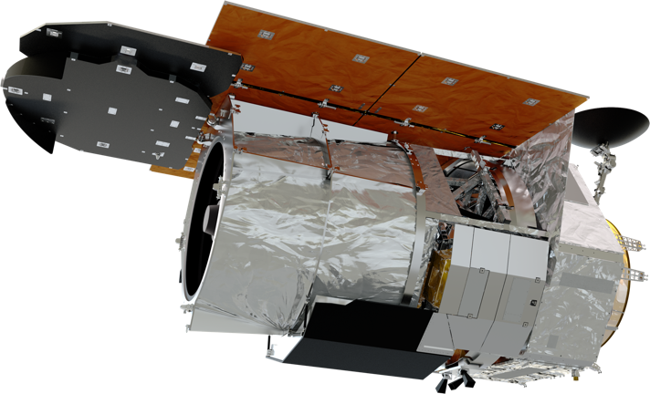
Roman Coronagraph Instrument
Reference Information
February 2021
Information here captures the instrument design elements as of the CGI Preliminary Design Review in September 2019.
Roman/CGI Science and Engineering Project Teams
Jet Propulsion Laboratory, California Institute of Technology

Slide 2
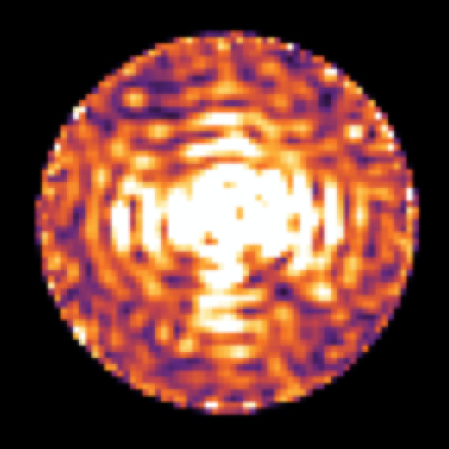
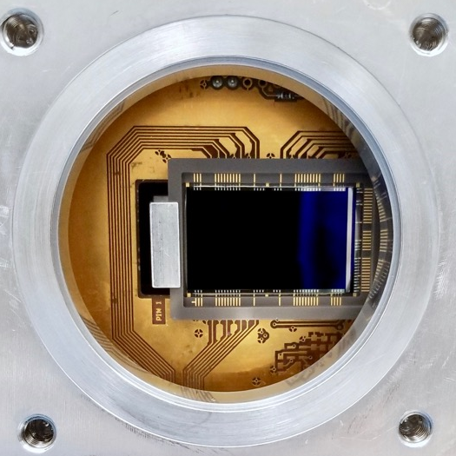
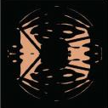
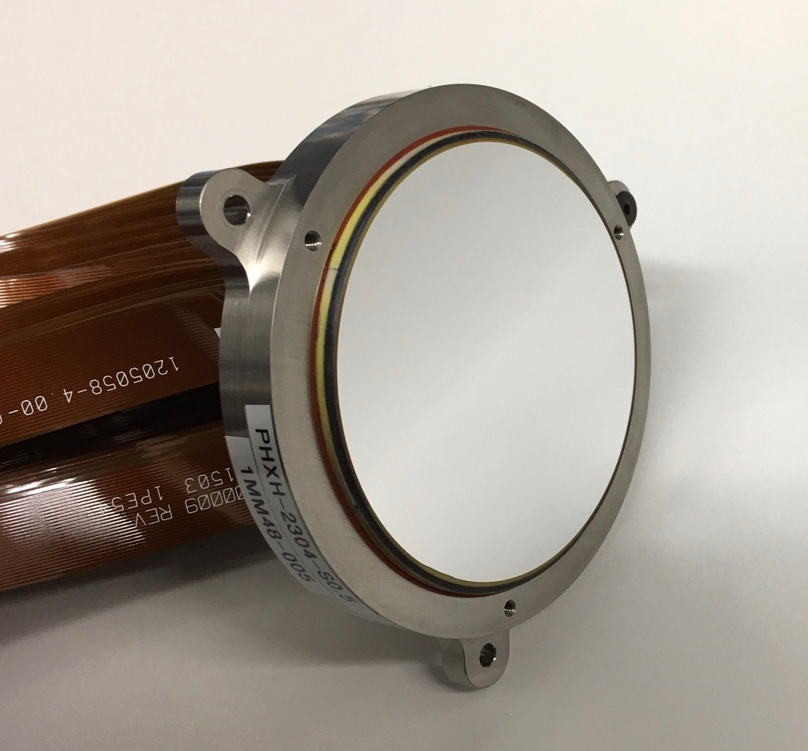
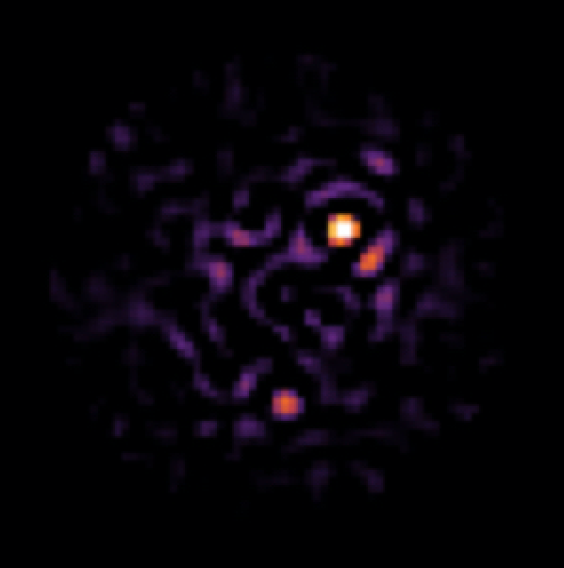
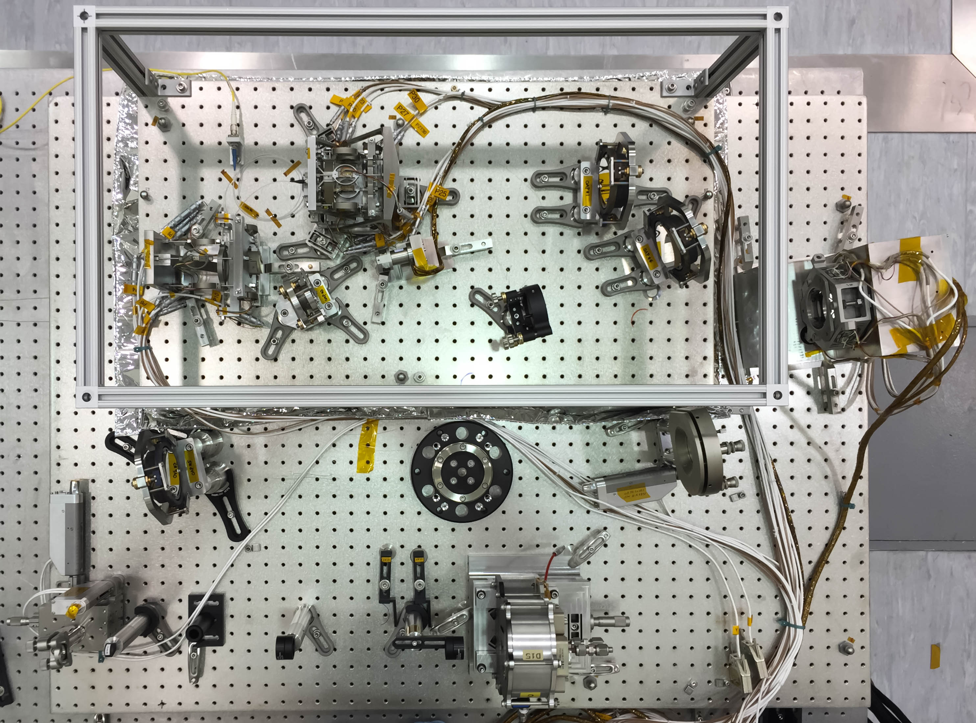
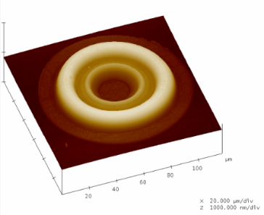
Critical Technology Demonstrations
CGI is an advanced technology demonstrator for future missions
that will directly image Earth-like exoplanets.
Data Post-
Processing
High-contrast Coronagraph Masks
Ultra-low noise photon counting EMCCD Detectors
Large-format Deformable Mirrors
Ultra-Precise Wavefront Sensing & Control
Bertrand Mennesson (JPL)
  CGI will premiere in space the technologies needed by future missions to image and characterize rocky planets in the habitable zones of nearby stars. By demonstrating these tools in a system with end-to-end, scientific observing operations, NASA will reduce the cost and risk of a potential future flagship mission.
Notes:
CGI is an advanced technology demonstrator for future missions that will directly image Earth-like exoplanets. (e.g. HabEx and LUVOIR)
As discussed before, these future missions to image earth-like planets will have to perform 10,000x better than today’s facilities. By demonstrating these tools in an integrated end-to-end system and enabling scientific observing operations, NASA will validate performance models and provide the pathway for potential future flagship missions.
In short, CGI achieves that capability through improvements in several areas:
Hardware: space-qualified (TRL9) deformable mirrors, detectors, and coronagraphs
Algorithms: wavefront sensing and control; post-processing of integral field spectrograph, polarimetric, and extended object data
Validation of telescope and instrument models at high accuracy and precision
Suppressing the starlight requires a combination of two things:
blocking as much starlight as possible with “coronagraph masks,” (think of how you use your hand to block the sun if you want to see a plane flying by)
Automatically measuring the remaining glare and correcting for it with a “deformable mirror.” Since light is a wave, astronomers call this process “wavefront sensing and control.” Deformable mirrors must be shaped very precisely in real time.
CGI will be the first space telescope with high-performance wavefront sensing and control. One of CGI’s primary goals is to figure out how to translate this ground-based technology into a hardy, space-qualified system, while simultaneously improving its performance by orders of magnitude. State of the art ground-based systems today can sense and correct wavefront errors to <100 nanometers (RMS). CGI must stabilize the wavefront to <100 picometers (RMS), and future exo-Earth imaging missions aim for <10 pm RMS.
CGI’s specially-designed coronagraph masks block starlight much better than those on current telescopes. These designs also have to be robust to effects that aren’t important at today’s poorer level of performance (such as accounting for the differences between the image quality in each polarization of light).
CGI will have advanced scientific cameras. It will include an ‘integral field spectrograph’ – a type of camera that takes a low resolution spectrum at every point in the image simultaneously. The most novel technology, though, is the electron-multiplying CCD (EMCCD) detector. This detector has exceptionally good sensitivity at very low light levels, and CGI will use it in uncharted territory – photon counting mode. A Jupiter-like planet around a nearby star is so faint that CGI will only receive photons from it once every couple minutes. CGI will literally count the photons as they arrive. JPL is working to space qualify these EMCCDs and characterize their performance at an unprecedented level of precision.
CGI must also build sophisticated data processing software, because even the precision coronagraphs + wavefront sensing and control can’t remove all the starlight. Data processing software must be able to remove the last of the remaining starlight to uncover the faint planets beneath.

Slide 3
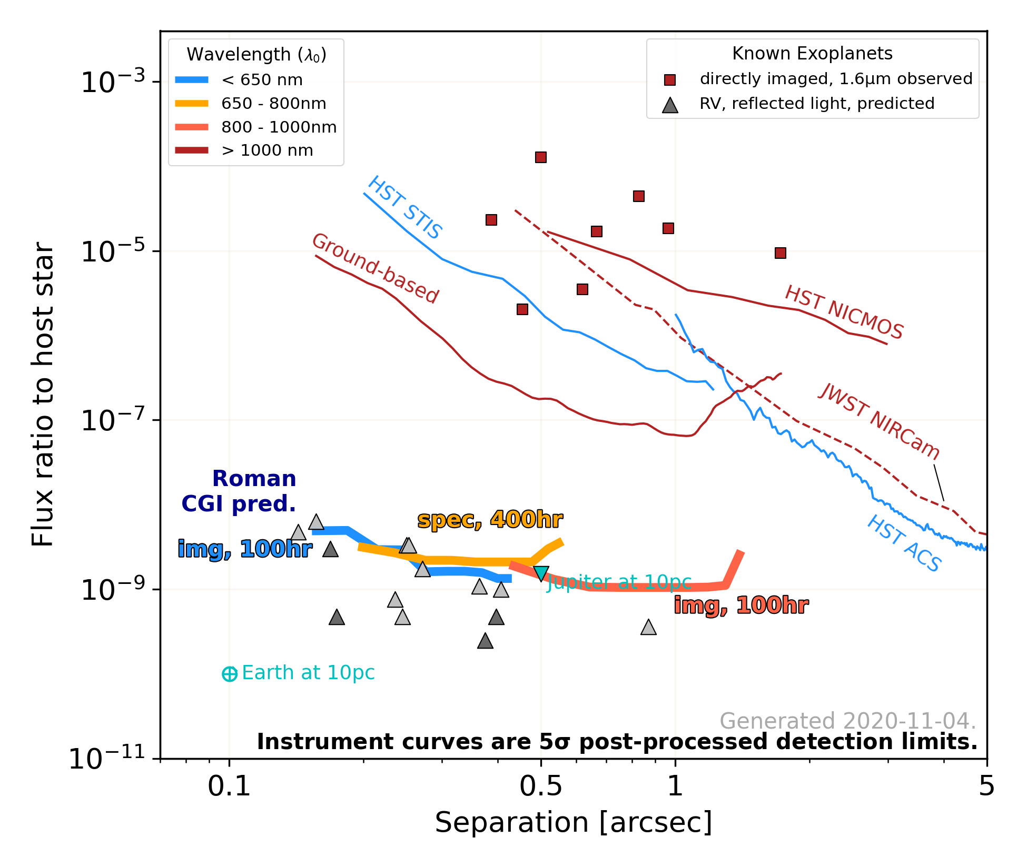
Required & Predicted CGI Performance in the Context of Existing Astronomy Capabilities
Instrument performance requirements and current-best-estimated performance are based on laboratory demonstrations and model predictions, as of November 11, 2020. Laboratory demonstrations and model refinements are ongoing.
See V. Bailey, https://github.com/nasavbailey/DI-flux-ratio-plot for a detailed description of this plot.
Notes:
Add link to submitted NAS Whitepaper to the Exoplanet Strategy.
Add caption with date here, edited from Vanesa’s blurb.-- This is Phase A, etc.

Slide 4
CGI Community Participation Program
CGI Delivery
Launch
Implementation, integration, test
C
TDP
Science phase?
2020
2023
Q4 2025
5 years
Feb 2020: Entered implementation phase (Phase C)
Q3 2023: Instrument delivery to payload integration & test
Q4 2025: Launch
Commissioning Phase
  450 hr in first 90 days after launch
Technology Demonstration Phase (TDP)
  ~2200 hr (3 months) baselined in next 1.5 years of mission
If TDP successful, potential science phase
  10-25% of remainder of 5 year mission
  Commission unofficial observing modes (add’l mask+filter combo’s)
  Support community engagement
  Not guaranteed: would require additional resources
  Starshade rendezvous, if selected
Notes:
In terms of schedule: we have begun implementation, with instrument delivery planned in the 2nd half of 2023. The observatory is planned to launch in late 2025, with an initial 90 day checkout period for the telescope and instruments. Then CGI is notionally allocated ~2200hr of observing time spread across the next 18 months of the mission. This is where we will check off our technology demonstration goals, using scientifically interesting targets that I’ll discuss in the next few slides. If CGI performs well, it may be possible to have an extended science phase later in the mission, as part of the ~25% allocated for GO programs. This science phase isn’t guaranteed or even funded, but it is possible. If starshade rendezvous is selected by the decadal survey, it would happen during this phase. The CPP would begin in mid 2021 and would cover various aspects from target selection and observation design to data processing and calibration to performance analysis to alternative wavefront sensing and control algorithm development. If you’re at a US institution, keep an eye out for a ROSES call later this year. If you’re not in the US but are in a Roman partner country or agency, you should inquire directly with your agency.

Slide 5
Potential Technology Demonstration Phase Observations
Self luminous planet image and spectra
Reflected light planet image and spectrum
Bright debris disk polarimetry
Faint debris disk detection

Slide 6
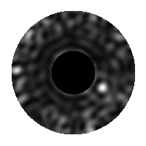
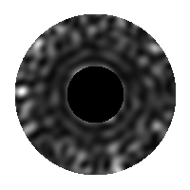
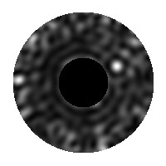
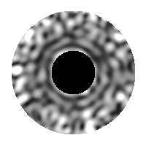




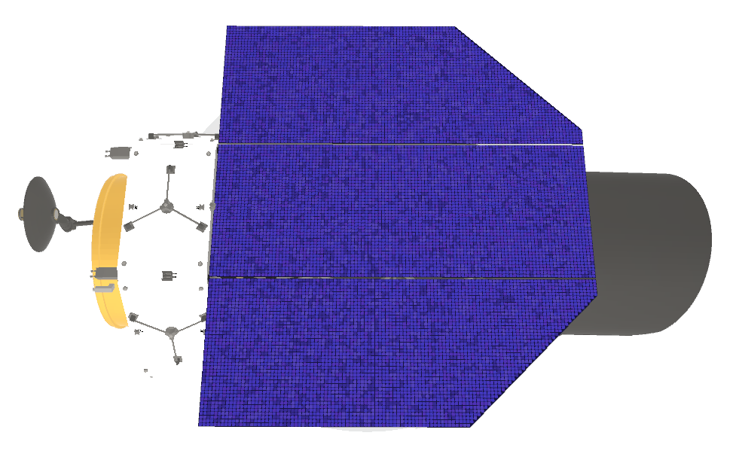
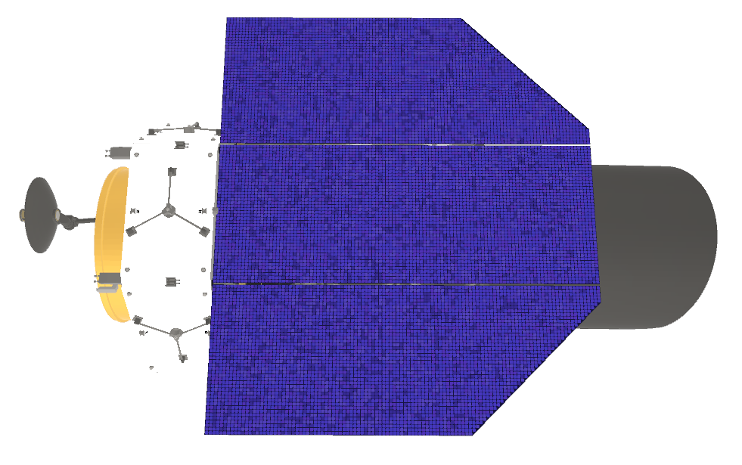
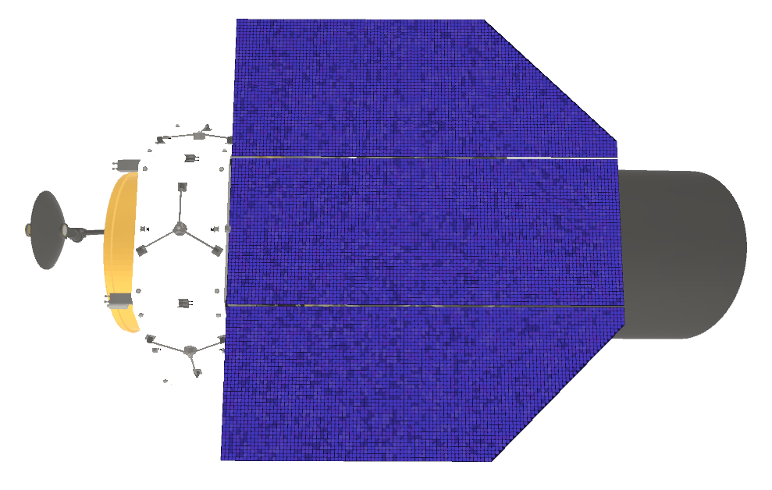
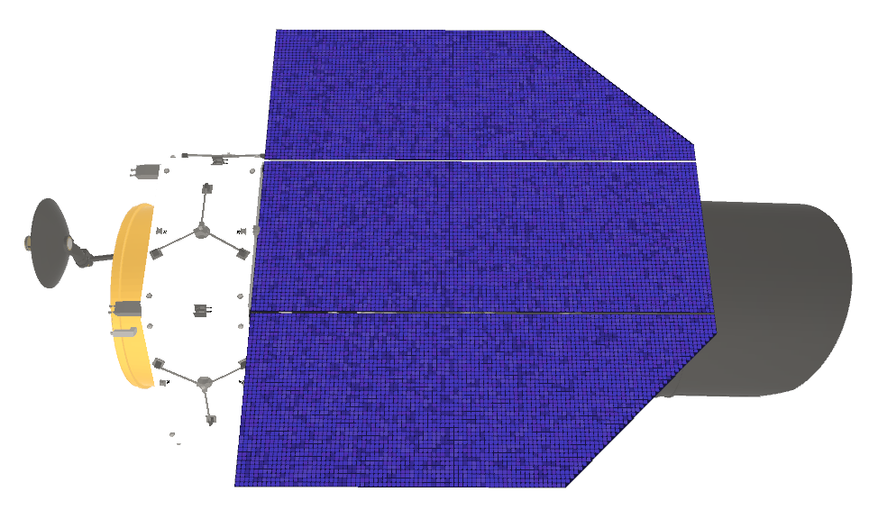
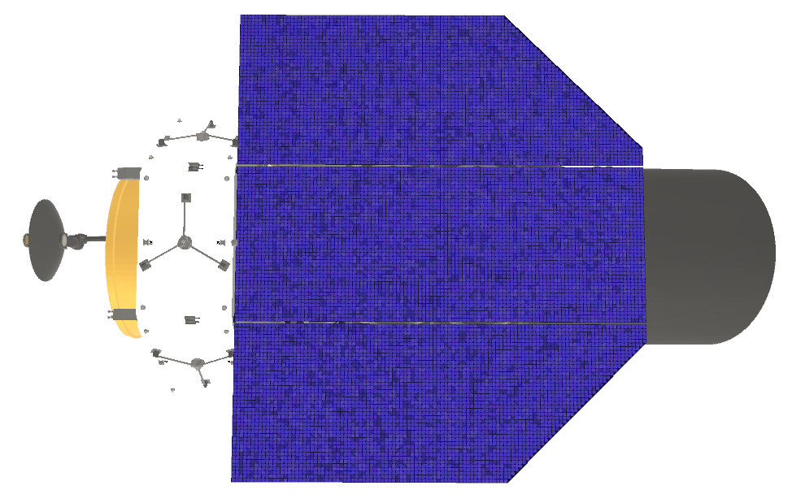
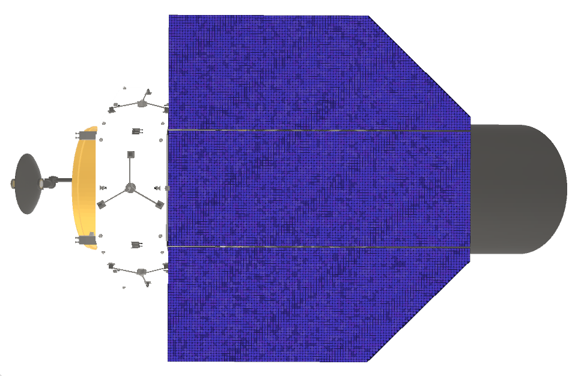
CGI Observing Scenario
Bright Reference Star
Target Star
John Krist (JPL)

Slide 7

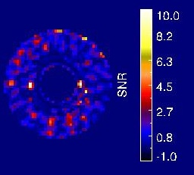
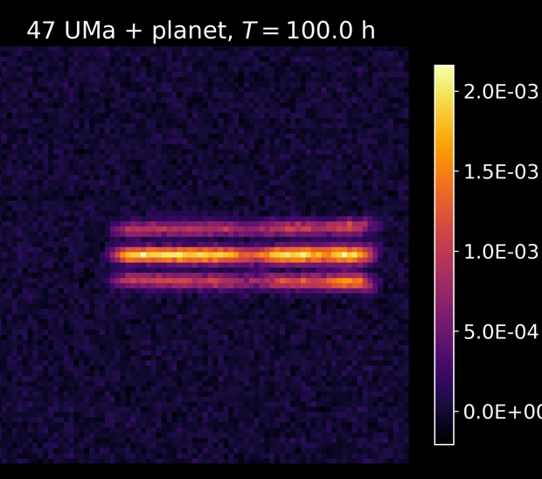
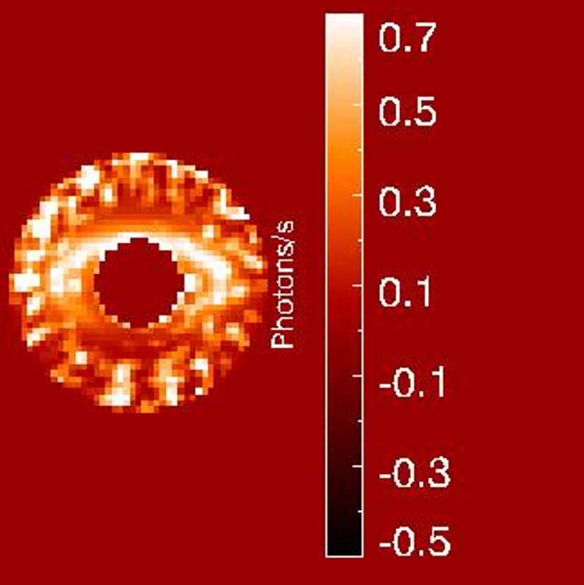
CGI Architecture
Pol.
Optional
Spectro-scopy
Pol.
Optional
OAP = Off-Axis Parabolic [Mirror]
Three observation modes implemented with three different sets of masks/filters
Share the same optical beam train, with two wavefront control loops to achieve high contrast (better than 1E-8)
Notes:
Ilya to present

Slide 8
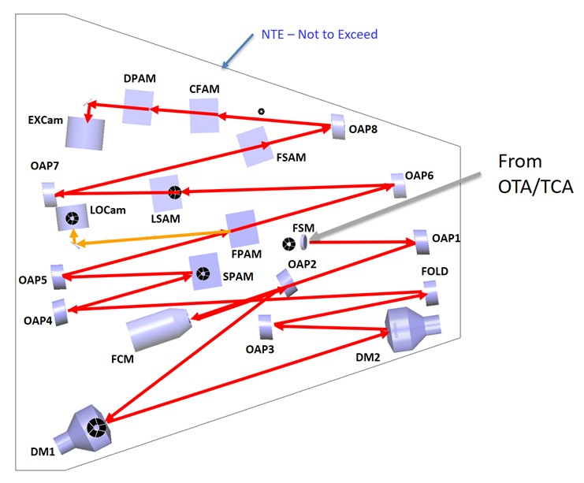
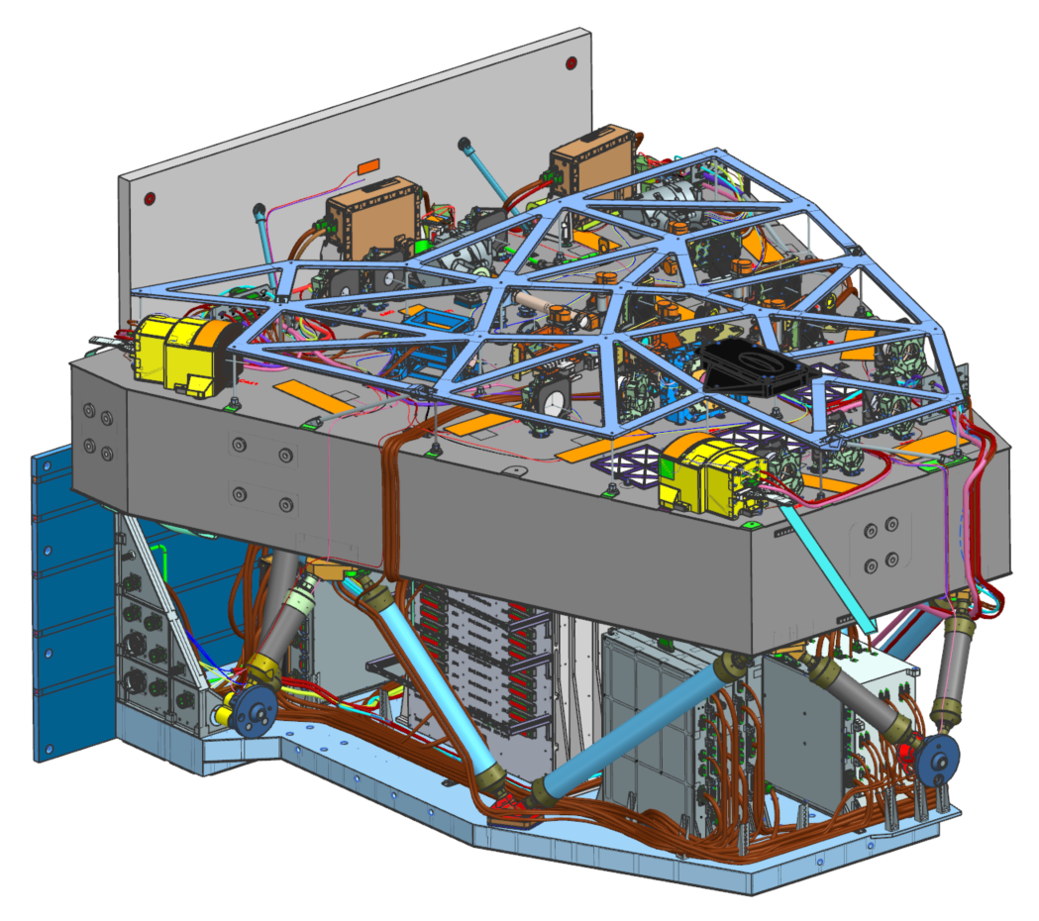
CGI Architecture
1687 mm
Harness
“Round Wire”
MLI Support Frame
Cyrogenic Thermal Sub-system
Instrument Interface “B”
Not Visible
Warm Electronics Radiator
Harness
“Flex”
(2x)
1092 mm
Optical Bench
S/C Connector Interface
Optical Bench Bipods
Instrument Interface “C”
Electronics Thermal Pallet
Instrument Interface “A”
1760 mm
Thermal Pallet Bipods
The first deformable mirror, DM 1, is positioned at a relay pupil following the FSM. DM 2 is positioned 1 meter away to enable correction of amplitude errors and phase errors originating from out-of-pupil surfaces.
Both coronagraph mask types, the Hybrid Lyot and Shaped Pupil Coronagraphs (HLC and SPC), are implemented on the same optical beam train and selected by changing masks at the planes labeled SPAM, FPAM, LSAM, and FSAM.
Observing mode is selected by mechanisms after the Lyot stop.
IFC
In the WFIRST Payload, CGI mounts onto the Instrument Carrier (IC) shared with the Wide Field Instrument. The Tertiary Collimator Assembly (TCA; not shown) is the optical interface between the telescope and CGI, and relays an exit pupil onto the Fast Steering Mirror (FSM).
Phase C design as of November 2020.
WFC

Slide 9



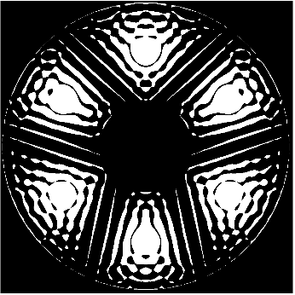



Coronagraph Elements
SPAM -
Shaped Pupil Alignment Mechanism
FPAM -
Focal Plane
Alignment Mechanism**
LSAM -
Lyot Stop
Alignment Mechanism
FSAM -
Field Stop
Alignment Mechanism
CFAM -
Color Filter
Alignment Mechanism
DPAM -
Dispersion/Prism Alignment Mechanism
λ₂
LC, λ₁
λ₁
Imaging Lenses
Mirror
λ₁
LC, λ₂
λ₁
ZWFS
Open
λ₄
λ₃’
Pinhole
OPEN
λ₂
λ₄
Pol. FS
λ₃
Pol Lenses
λ₃
Pinhole
Dark mask
λ_{1a,}
_{1b, 1c}
x3
Spectro Slits (x4)
λ_{4a,}
_{4b, 4c}
Spectro 2
ND 1
x3
λ₄
λ₃
λ₂
λ_{2a,}
_{2b, 2c}
Spectro 3
SPARE
ND 2
OPEN
x3
SPARE
λ₄
λ₁’
λ₁
λ₁
λ_{3a,}
_{3b, 3c,}
_{3d, 3e, 3g}
x3
Pupil Lens
λ₁
x6
λ₂
λ₂’
SPARE
SPARE
Diffuser (TBR)
Pinhole
LC, λ₃
Pol. FS
x5
HLC, λ₄
SPARE x2
CLEAR
Phase Retrieval
LC, λ₄
x4
HLC, λ₃
ZWFS
ND
Acq Dark
Open
(no substrate)
Open
(no substrate)
**Magnified for illustration. Each FPAM substrate can carry multiple coronagraphic elements.
Blue indicated contributed optics that are not part of requirements
λ₁ = 575 nm, 10% λ₂ = 660 nm, 15%
λ₃ = 730 nm, 15% λ₄ = 825 nm, 10%

Slide 10
CGI Passbands
Band 1
Imaging & Polarimetry
Band 3
R~50 Spectroscopy
CH₄
Band 4
Imaging & Polarimetry
Three “official” modes will be fully tested prior to launch
(Bands 1, 3, and 4)
CH₄
Band 2
R~50 Spectroscopy
H⍺
“Engineering” filters
Additional modes installed but not fully tested before launch
December 2019

Slide 11
CGI Observing Modes
Three “official” modes will be fully tested prior to launch.
λ_{center} (nm) | FWTB | Mode | FOV radius | Polarimetry?
575 | 10.1% | Imager | 0.14” – 0.45” | Y
730 | 15.1% | Slit + R~50 Prism | 0.18” – 0.55” | -
825 | 9.9% | Imager | 0.45” – 1.4” | Y

Slide 12
CGI Narrowband Modes
Additional modes installed but not fully tested before launch
λ_{center} (nm) | FWTB | Mode | FOV radius | Polarimetry?
660 | 15.2% | Slit + R~50 Prism | 0.17” – 0.5” | Y
Hα | 0.4% | Imager | 0.17” – 0.5” | Y

Slide 13
CGI Narrowband Modes
Wavefront Control Engineering Bandpasses (2.5-3.5%) installed
Name | λ_{min} [nm] | λ₀ [nm] | λ_{max} [nm] | FWTB [%] | width [nm]
1a | 540 | 550 | 560 | 2.5 | 20
1b | 564.5 | 575 | 585.5 | 2.6 | 21
1c | 588 | 599 | 610 | 2.7 | 22
2a | 604 | 615 | 626 | 2.6 | 22
2b | 629 | 638 | 647 | 1.9 | 18
2c | 653 | 656.3 | 659.6 | 0.4 | 6.6
3a | 669 | 681 | 693 | 2.6 | 24
3b | 692 | 704 | 716 | 2.6 | 24
3c | 717 | 727 | 737 | 2.0 | 20
3g | 739.5 | 752 | 764.5 | 2.5 | 25
3d | 750.25 | 754 | 757.75 | 0.5 | 7.5
3e | 764 | 777.5 | 791 | 2.7 | 27
4a | 778 | 792 | 806 | 2.8 | 28
4b | 810 | 825 | 840 | 2.9 | 30
4c | 842 | 857 | 872 | 2.8 | 30

Slide 14
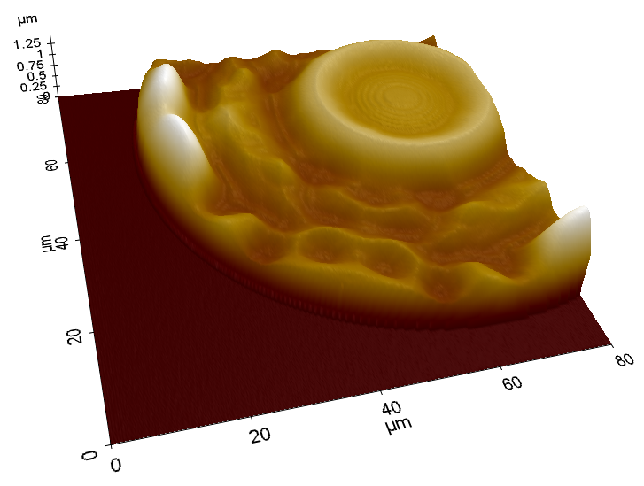
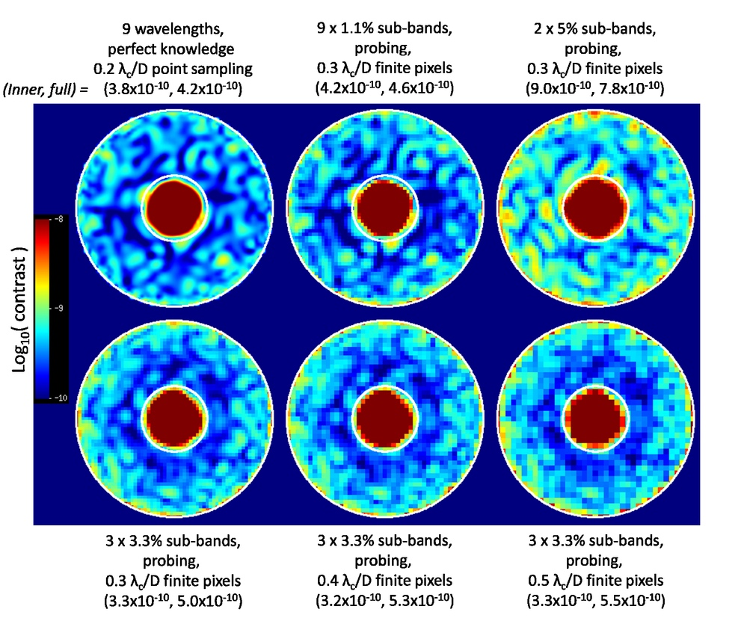

Hybrid Lyot Coronagraph
The HLC provides a full 360° high contrast field of view.
Focal plane occulting mask is a circular, r = 2.8 λ_{c}/D partially-transmissive nickel disc overlaid with a PMGI dielectric layer with a radially and azimuthally varying thickness profile.
The HLC design incorporates a numerically optimized, static actuator pattern applied to both deformable mirrors.
Lyot stop is an annular mask that blocks the telescope pupil edges and struts.
HLC occulting mask. AFM surface height measurement of an occulting mask fabricated by the JPL Micro Devices Lab. Recent design refinements include azimuthal ripples in thickness of the dielectric, which extends across the field of view.
Simulated HLC PSF including aberrations and high-order wavefront control operations, illustrating the annular dark zone between 3 and 9 λ_{c}/D. Each sub-panel represents a different scenario for DM probe wavelength resolution and detector sampling.
HLC Lyot stop. Diagram of Lyot stop model: white represents the transmitted region; black represents the telescope pupil; gray represents the region blocked by the stop in addition to the telescope pupil.
References
J. Trauger, D. Moody, et al., JATIS Vol 2, id. 011013 (2016) - https://doi.org/10.1117/1.JATIS.2.1.011013
J. Krist, et al., Proc SPIE Vol 10400, id. 1040004. (2017) - http://dx.doi.org/10.1117/12.2274792
K. Balasubramanian, et al., Proc SPIE Vol 10400, id. (2017) - https://doi.org/10.1117/12.2274059

Slide 15
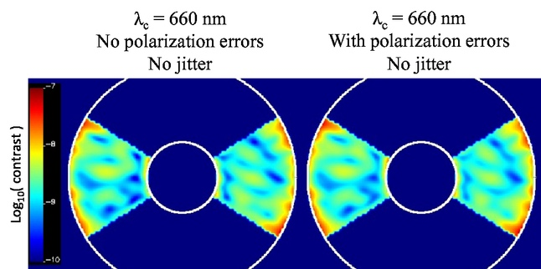
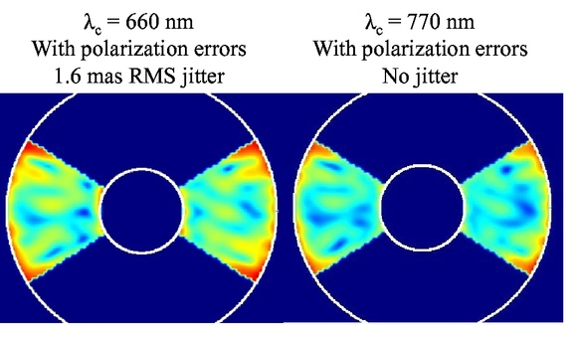



Shaped Pupil Coronagraph
The shaped pupil apodizer is a reflective mask on a silicon substrate with aluminum regions for reflection and black silicon regions for absorption.
The hard-edged occulting mask has either a bowtie-shaped opening for characterization (spectroscopy) mode or an annular aperture for debris disk imaging.
The SPC Spectroscopy designed in 2017 produces a 2 x 65° bowtie dark zone from 3.0 – 9.1 λ_{c}/D over a 15% bandpass.
The SPC Wide Field of View design produces a 360° dark zone from 5.9 – 20.1 λ_{c}/D in a 10% bandpass.
Apodizer Mask
Focal Plane Mask
Lyot Stop
Spectroscopy SPC (2017 design) simulations at λ_{c} = 660 and 770 nm including system aberrations, pointing jitter, and wavefront control operations. The circles correspond to r = 3 and 9 λ _{c} /D.
References
N. T. Zimmerman, et al., JATIS Vol 2 id. 011012 (2016) - http://dx.doi.org/10.1117/1.JATIS.2.1.011012
K. Balasubramanian, et al., JATIS Vol2 id. 011005 (2015) - https://doi.org/10.1117/1.JATIS.2.1.011005
A. J. E. Riggs et al., N. T. Zimmerman, et al., Proc SPIE Vol 10400 (2017) - http://dx.doi.org/10.1117/12.2274437
J. Krist, et al., Proc SPIE Vol 10400, id. 1040004. (2017) - http://dx.doi.org/10.1117/12.2274792
Flight mask designs for the spectroscopy shaped pupil coronagraph.
Design by A.J. E. Riggs (JPL).

Slide 16
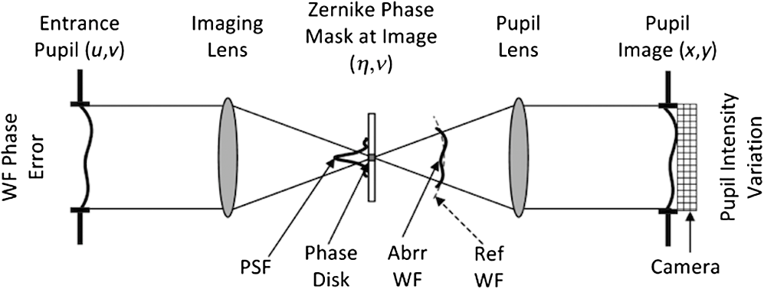
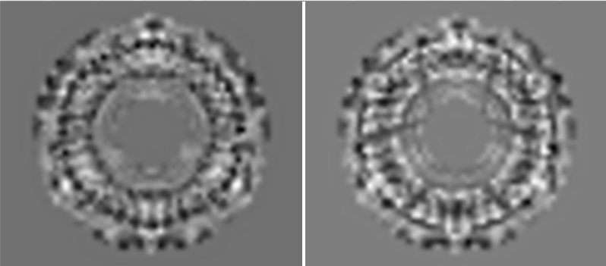
Wavefront Control
The baseline CGI design includes four active optics to control the wavefront: a fast steering mirror (FSM), a flat focusing mirror (FCM), and two deformable mirrors (DM 1 and DM 2) with 48x48 actuators each.
High-order wavefront control is implemented by the Electric Field Conjugation (EFC) method. The EFC loop operates on science focal plane data by measuring the interaction of aberrated on-axis starlight with a sequence of DM actuator probes.
Pointing, focus, and low-order wavefront drifts are sensed by the Low-Order Wavefront Sensing and Control (LOWFS/C) subsystem using the Zernike phase-contrast technique on starlight rejected from the occulting mask. Corrections to Zernike modes Z5—Z11 are applied to DM 1.
The FSM control loop corrects line-of-sight pointing jitter to below 0.95 milliarcsec.
Conceptual diagram of the Zernike phase contrast wavefront sensor (F. Shi, et al., 2016).
DM1 DM2
Optimized DM surfaces applied in HLC data simulations.
References
T. Groff, A. J. E. Riggs, et al., JATIS Vol 2, id 011009 (2015) - https://doi.org/10.1117/1.JATIS.2.1.011009
F. Shi, et al., JATIS Vol 2, id 011021 (2016) - https://doi.org/10.1117/1.JATIS.2.1.011021
J. Krist, et al., JATIS Vol 2, id 011003 (2015) - https://doi.org/10.1117/1.JATIS.2.1.011003

Slide 17
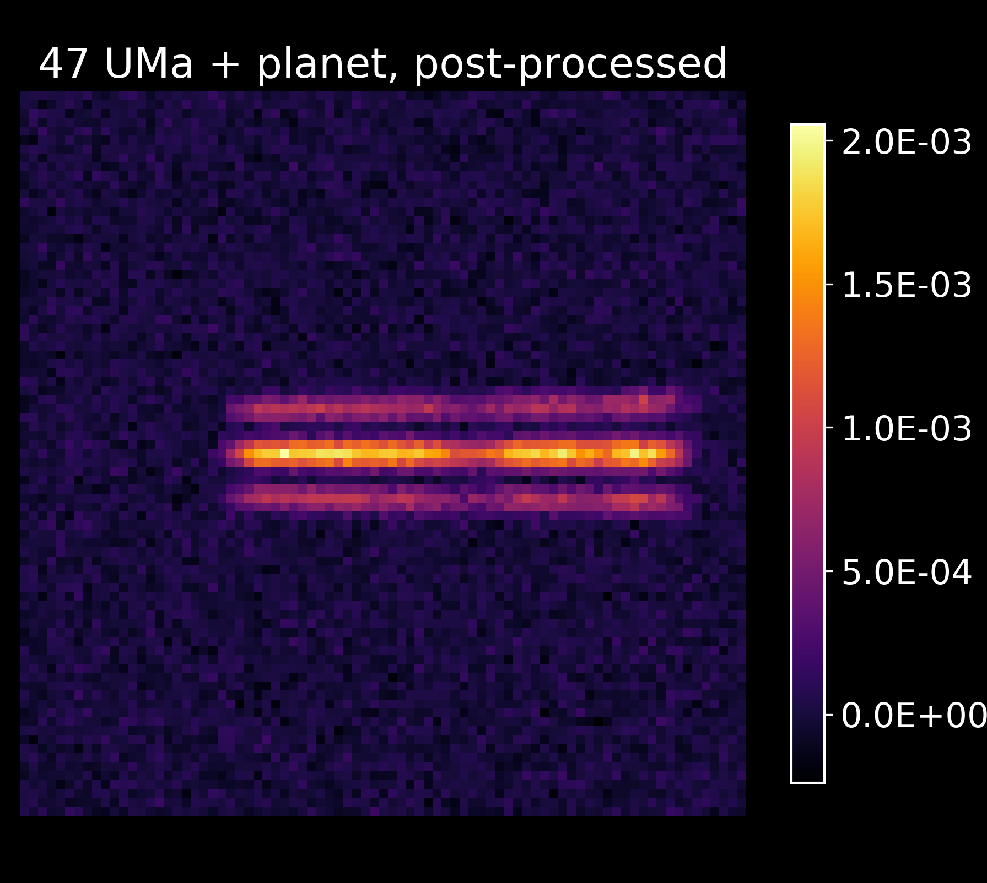

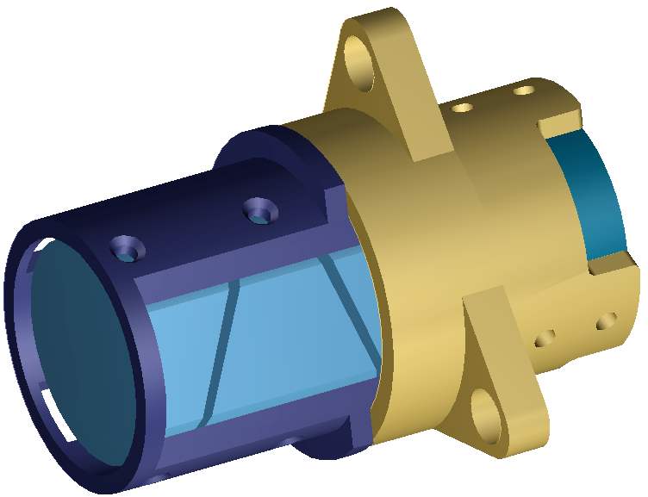
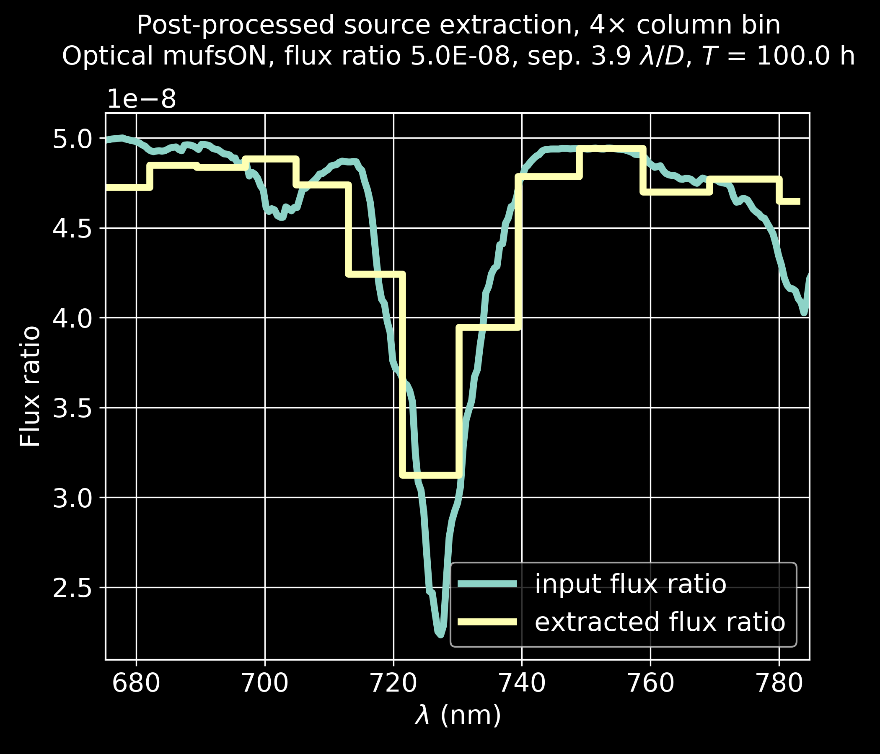
CGI Spectroscopy
CGI will be capable of R_{λ center} = 50 spectroscopy using a slit and Amici prism in Bands 2 and 3
SPC images in 15% band
Amici prism
Linear dispersion
Wavelength (nm)
Notes:
Actuated TCA mirror?

Slide 18
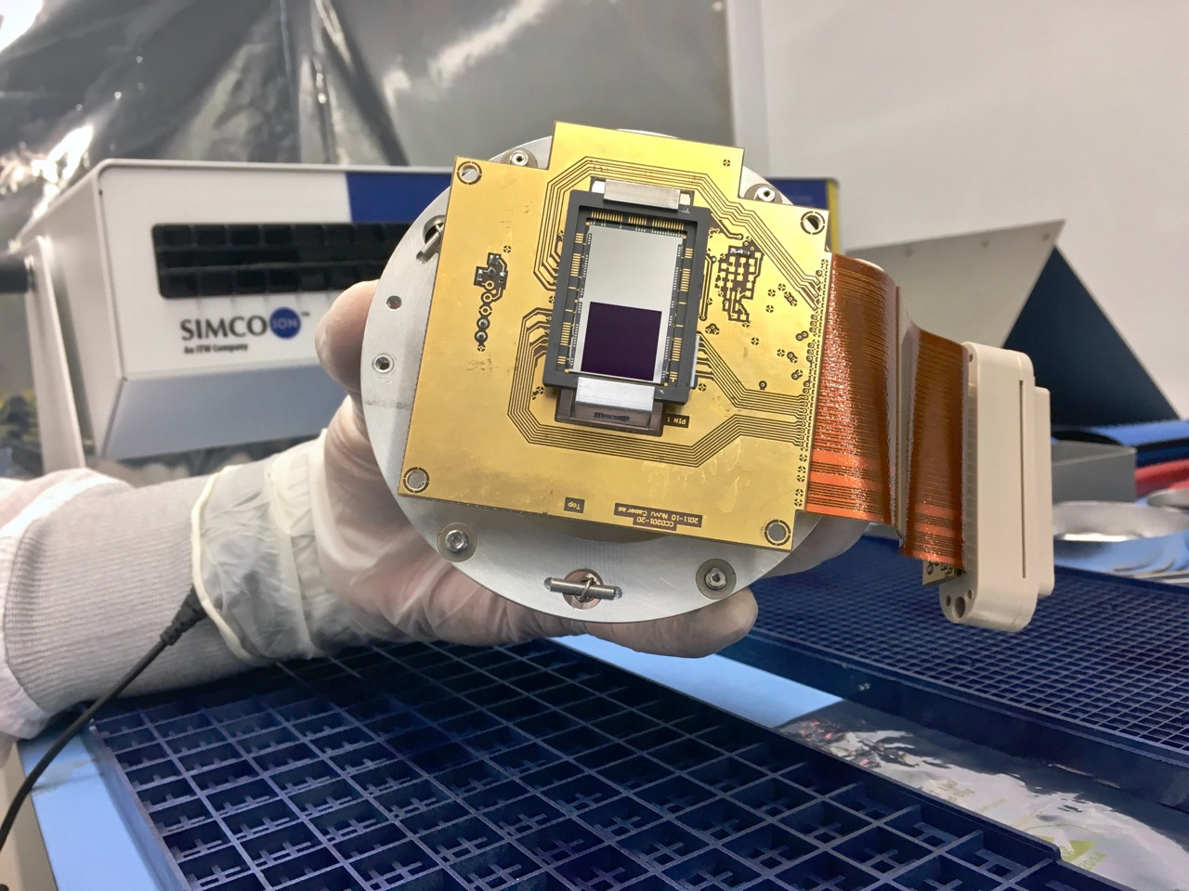
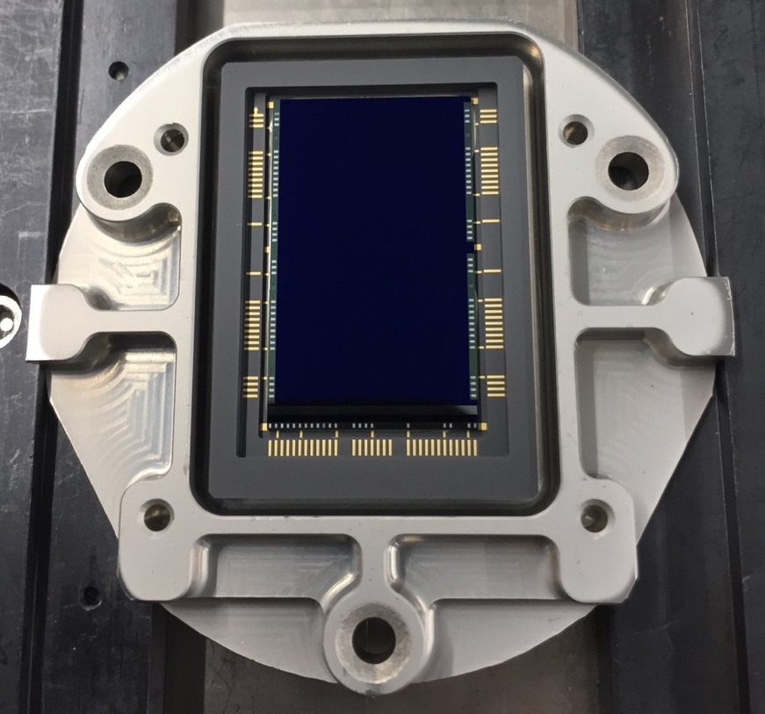
EMCCD Detectors
Electron Multiplying CCD (EMCCD) technology is advantageous for a coronagraph application.
  Programmable gain provides wide dynamic range suitable for bright scenes expected during acquisition and coronagraph configuration, while photon counting capability can be used for faint light observations with zero read noise.
EMCCD detectors are baselined for direct imaging, spectroscopy and wavefront sensing applications in CGI.
  Subarray readout suitable for a wavefront sensor application enables 1000 frame-s⁻¹ operation to accommodate tip-tilt sensing.
Work at JPL is focused on low flux characterization with radiation damaged sensors.
  JPL has invested in modifications to the commercial version of the EMCCD that are expected to improve margins against radiation damage in a flight environment. Prototypes with flight silicon will be delivered in July 2021.
JPL’s EMCCD test lab has measured a low flux threshold of 0.002 c-psf⁻¹-s⁻¹, equivalent to a 32.4 magnitude star through a 2.4m telescope at 500 nm with 10% bandwidth.
  Devices irradiated to 5 years equivalent life at L2 meet coronagraph technology requirements.
Radiation-hardened EMCCDs are in Production
Commercial EMCCD
Flight Prototype EMCCD
References
L. Harding, R. Demers, et al., JATIS Vol 2, id 011007 (2016)

Slide 19
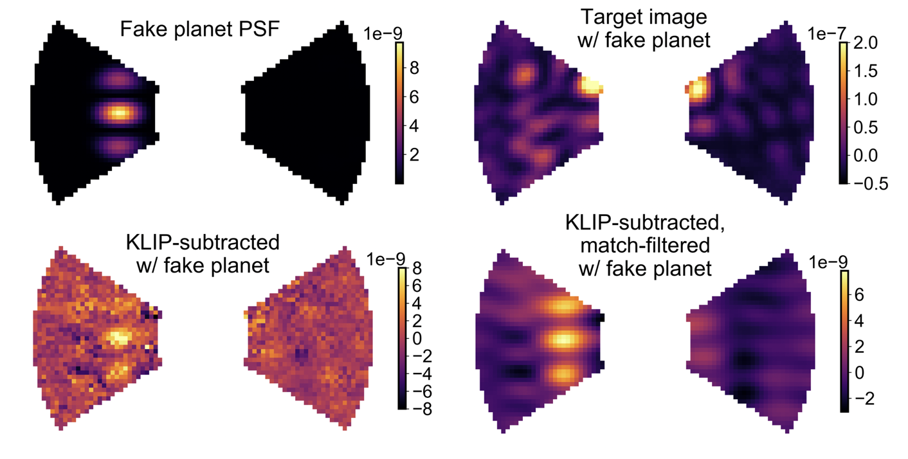
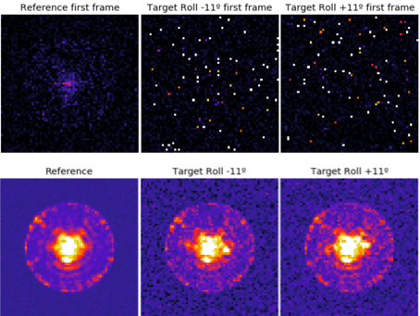
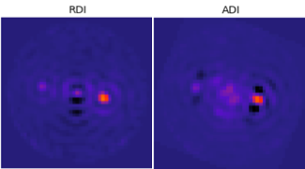
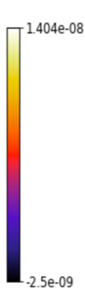
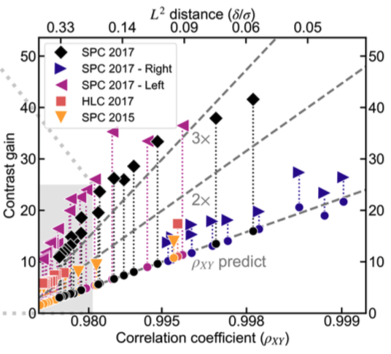
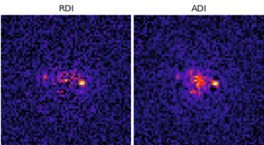
Data Post-Processing
Investigations on algorithms for CGI data post-processing have encompassed both end-to-end data simulations and analysis of laboratory testbed data.
Reference differential imaging (RDI) trials have probed a range of wavefront stability and noise scenarios. Simulations with spacecraft rolls have also enabled tests of Angular differential imaging (ADI).
2. Laboratory SPC bow-tie frame recorded at HCIT in a static environment (essentially noiseless other than speckles) with injected fake planet at 10⁻⁸ flux ratio
1. Post-Processing of OS9 Simulated HLC-Band 1
From raw to photon-counted data
Classical PSF subtraction
Example application of RDI to SPC data from HCIT, demonstrating the matched-filtered recovery of a fake point source inserted into one image (circled in red)
Left: Post-processing contrast gain plotted against reference library correlation for five datasets. Above a certain correlation coefficient, the post-processing gain is comparable to the gain from classical PSF subtraction.
References
M. Ygouf, N. Zimmerman, L. Pueyo, R. Soummer, et al., Proc. SPIE Vol 9904 (2016) - http://dx.doi.org/10.1117/12.2231581
Ygouf et al., 2020

Slide 20
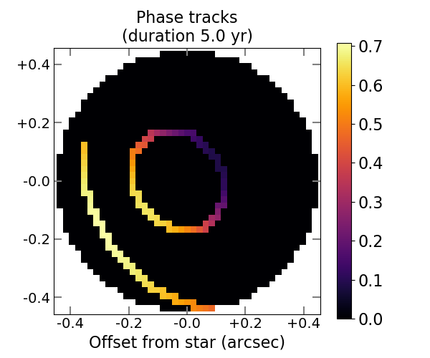
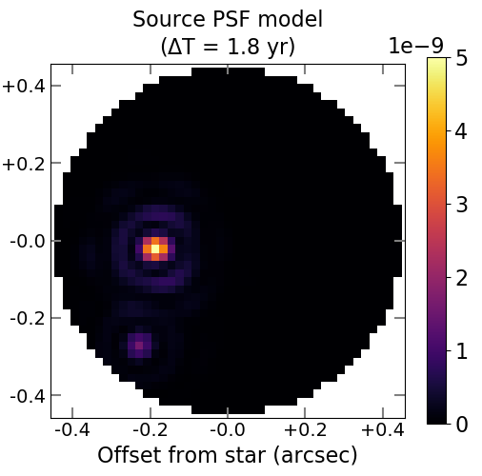
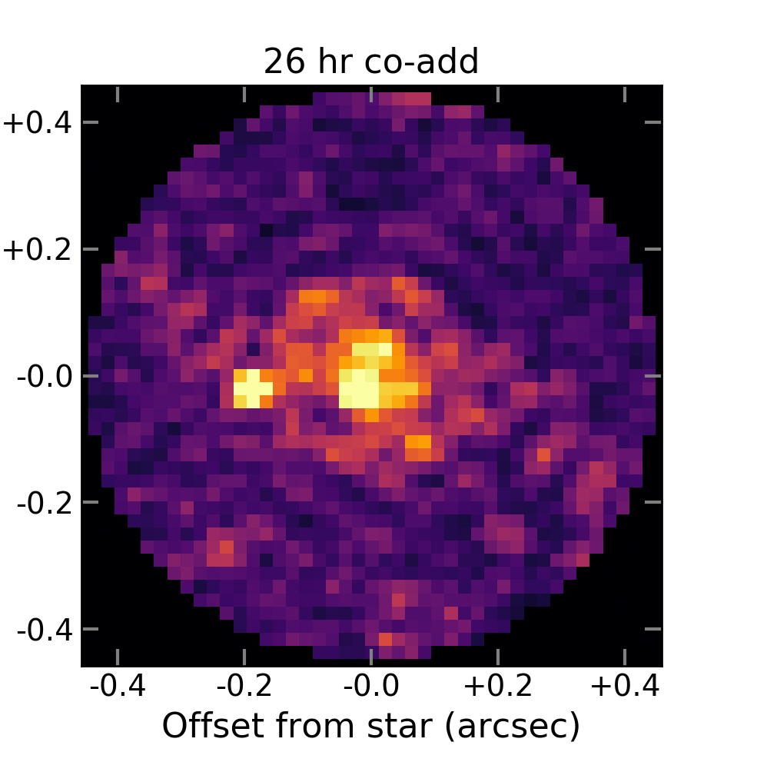
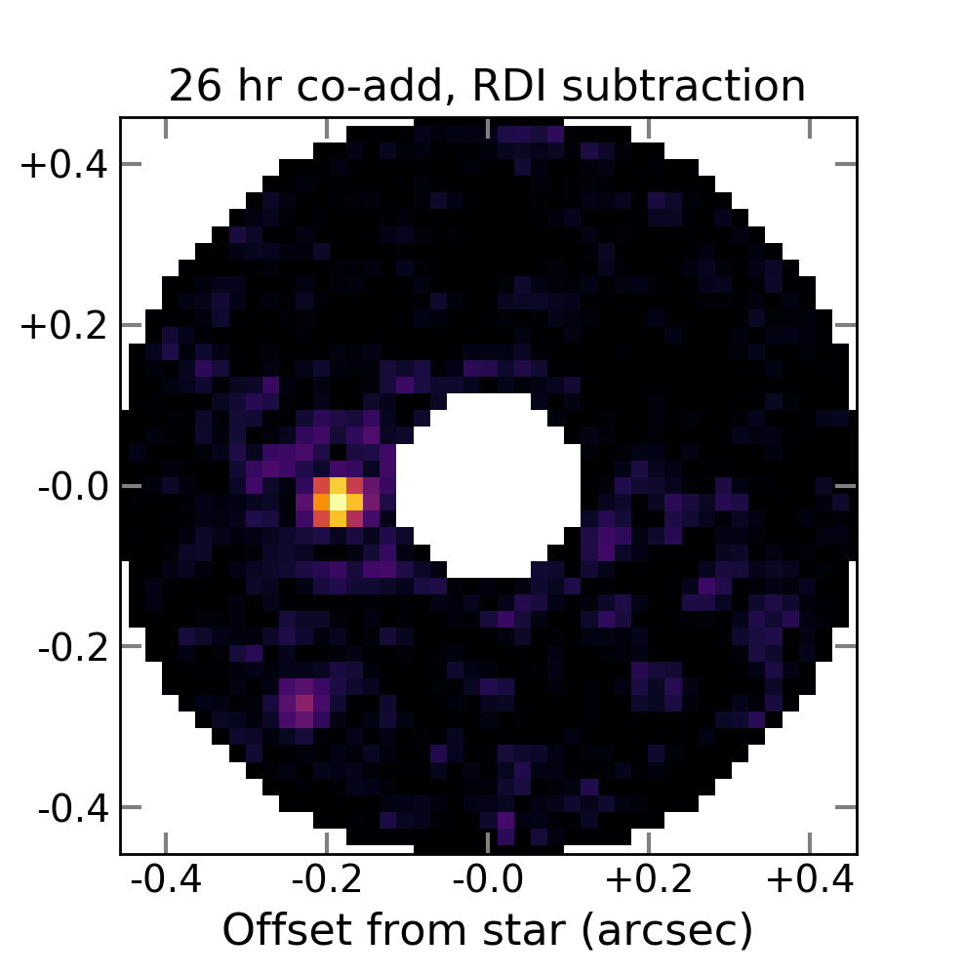
Community Data Challenges
(1)
(2)
The WFIRST Exoplanet Data Challenges are a series of blind retrieval exercises based on simulated CGI data to explore instrument capabilities, and inform design choices and operations concepts.
Imaging challenge launched Oct 20, 2019
  6 imaging epochs (4 HLC and 2 SS) of 47 Uma throughout CGI mission
  At least 1 planet has matching and realistic radial velocity data
  Extract sources, compute relative photometry & astrometry, disentangle from background sources, exozodiacal light
  Compute orbital solution using all the information available
    Teams have 4 months to gradually recover a full exoplanetary system
    4 step submission dates: Nov 20, Dec 20, Jan 20, Feb 20
    exoplanetdatachallenge.com
4 tutorial “hackathon events” were organized between March and October 2019 in Baltimore, Pasadena, New York City, and Tokyo
(3)
(4)
Image data challenge under preparation: (1) Model phase function tracks for a 2-planet system; (2) Source PSF model at one epoch; (3) Simulated co-add based on OS6 HLC time series; (4) Recovery of scene after RDI post-processing.

Slide 21
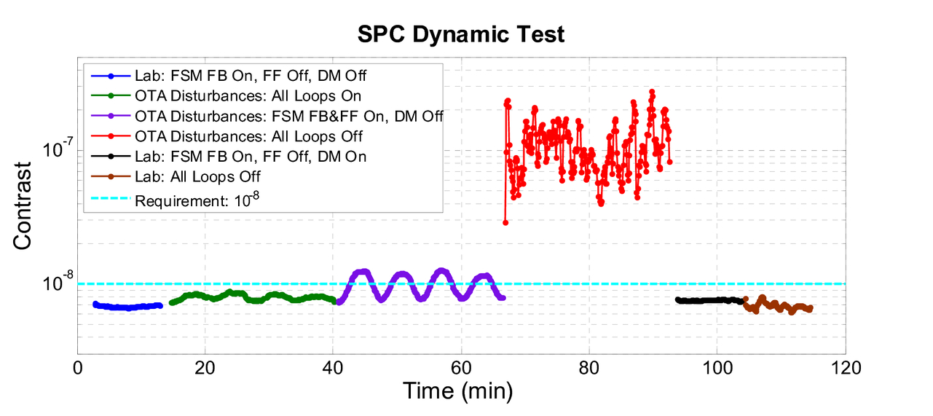
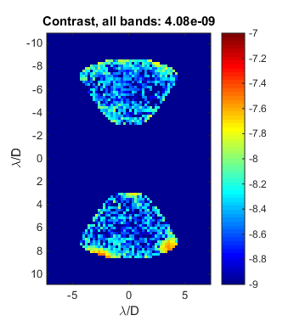
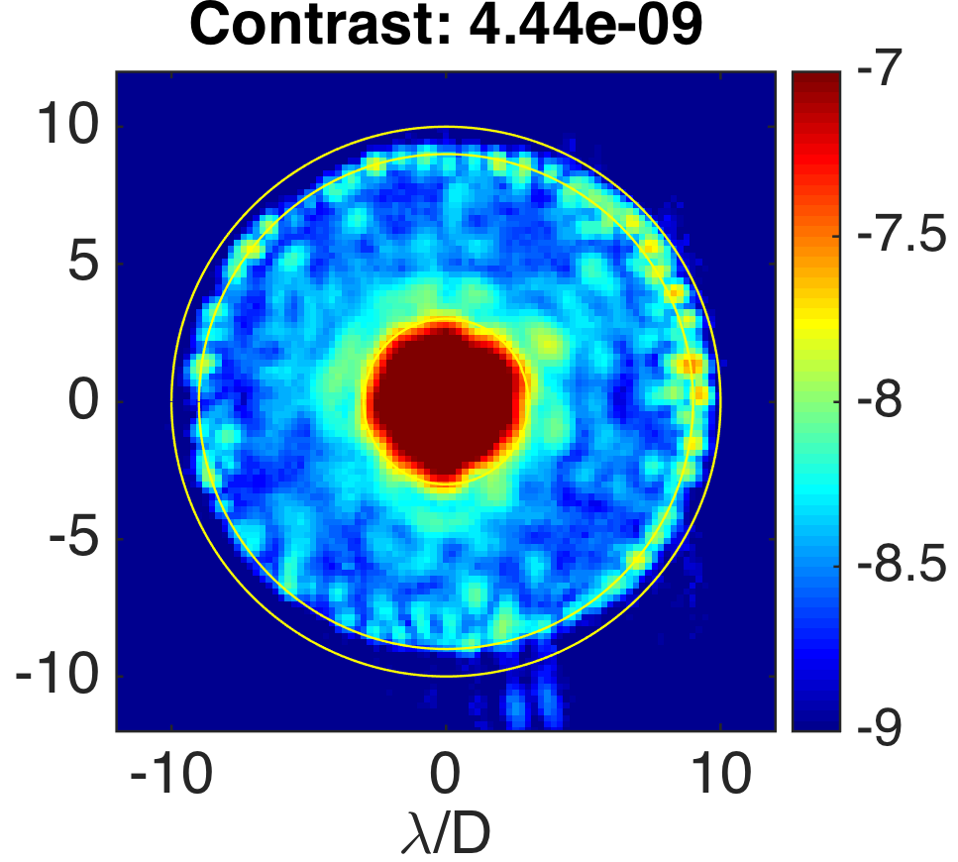
Laboratory Demonstrations
Results from the Occulting Mask Coronagraph (OMC) Testbed at JPL HCIT
SPC
HLC
Dynamic contrast demonstration with a Low Order Wavefront Sensing and Control (LOWFS/C) system integrated on the Occulting Mask Coronagraph testbed. When line-of-sight disturbances and low order wavefront drift (slow varying focus) are introduced on the testbed, the LOWFS senses the pointing error and wavefront drift and corrects them by commanding a fast steering mirror and one of the DMs. Demonstrations with both the SPC and HLC masks surpassed their 1E-8 contrast goal (F. Shi, et al., Proc SPIE Vol 10400, 2017).
Normalized intensity maps measured on the OMC testbed in broadband (10 %) light for SPC (left) and HLC. The total contrast between 3 – 9 λ/D is listed on top of each figure.
References
F. Shi, E. Cady, et al., Proc. SPIE Vol 10400 (2017) - http://dx.doi.org/10.1117/12.2274887
E. Cady, K. Balasubramanian, et al., Proc. SPIE Vol 10400 (2017) - http://dx.doi.org/10.1117/12.2272834
B.-J. Seo, E. Cady, et al., Proc SPIE Vol 10400, 10.1117/12.2274687 (2017) - http://dx.doi.org/10.1117/12.2274687
F. Shi, et al., Proc. SPIE Vol 10698 (2018) - https://doi.org/10.1117/12.2312746
B.-J. Seo, et al, Proc. SPIE Vol 10698 (2018) - https://doi.org/10.1117/12.2314358
D. Marx, et al, Proc. SPIE Vol 10698 (2018) - https://doi.org/10.1117/12.2312602
F. Shi, et al., Proc. SPIE Vol 11117 (2019) - https://doi.org/10.1117/12.2530486

Slide 22
Simulation Resources
Name | Author | Description | Format | URL | References
WFIRST Coronagraph Instrument (CGI) Imaging Simulations | John Krist (JPL) | Time series CGI imaging data simulations produced by JPL, incorporating observatory STOP models and wavefront control. | FITS files | https://roman.ipac.caltech.edu/sims/Coronagraph_public_images.html | J. Krist, et al., JATIS Vol 2, id. 011003 (2016) J. Krist, et al., Proc SPIE Vol 10400, id. 1040004. (2017)
EXOSIMS | Dmitry Savransky (Cornell U.) | Exoplanet Open-Source Imaging Mission Simulator, with dedicated configurations for simulating CGI surveys and integration times. | web browser interface | https://roman.ipac.caltech.edu/sims/tools/exosimsCGI/exosimsCGI.html | D. Savransky & D. Garrett, JATIS Vol 2, id. 011006 (2016) C. Delacroix, D. Savransky, et al., Proc SPIE Vol 9911, id. 991119 (2016)
 |  |  | Python source code | https://github.com/dsavransky/EXOSIMS
WebbPSF | Marshall Perrin (STScI) | Simulated Point Spread Functions for WFIRST WFI and CGI (static) | Python source code, with tutorials | https://github.com/mperrin/webbpsf | M. Perrin, et al., Proc SPIE Vol 8442, article id. 84423D (2012) M. Perrin, et al., Proc SPIE Vol 9143, id. 91433X (2014)
CRISPY | Maxime Rizzo (GSFC) | Coronagraph Rapid Imaging Spectrograph in Python - IFS simulations, tools for laboratory testbed demonstrations. | Python source code, with descriptive overview | https://roman.ipac.caltech.edu/sims/Crispy_simulations.html | M. Rizzo, et al., Proc SPIE Vol 10400, id. 104000B (2017)

Slide 23
Simulation Resources
Name | Author | Description | Format | URL | References
Fast Linearized Coronagraph Optimizer (FALCO) | AJ Riggs (JPL) | wavefront correction simulator, DM-integrated coronagraph design, testbed operation. CGI simulations | MATLAB and Python3 source codes with Wiki | https://github.com/ajeldorado/falco-matlab https://github.com/ajeldorado/falco-python https://github.com/ajeldorado/falco-matlab/wiki
FALCO + WFIRST CGI PROPER model | AJ Riggs (JPL) | Run end-to-end HOWFSC with the official Phase B model of the WFIRST CGI; Produces: CGI dark hole images and performance tables | MATLAB | https://github.com/ajeldorado/falco-matlab/wiki/01b%29-Examples-using-the-WFIRST-CGI-PROPER-model
Starshade Imaging Simulation Toolkit (SISTER) | Sergi R. Hildebrant (JPL) | produces: end-to-end images of an arbitrary user-defined exoplanetary system and background as observed by a starshade and a telescope | MATLAB | http://sister.caltech.edu | Hildebrandt et al. 2019, American Astronomical Society Meeting #234, id. 129.01. Bulletin of the American Astronomical Society, Vol. 51, No. 4

Slide 24
Reference Documents
Reference | URL | Year
Wide-Field Infrared Survey Telescope-Astrophysics Focused Telescope Assets (WFIRST-AFTA) 2015 Report by the Science Definition Team (SDT) and WFIRST Study Office | https://roman.gsfc.nasa.gov/science/sdt_public/WFIRST-AFTA_SDT_Report_150310_Final.pdf | 2015
Journal of Astronomical Telescopes Instruments and Systems, Vol. 2, No. 1, Special Section on WFIRST-AFTA Coronagraphs, eds. Olivier Guyon and Motohide Tamura | https://www.spiedigitallibrary.org/journals/Journal-of-Astronomical-Telescopes-Instruments-and-Systems/volume-2/issue-01#Editorial | 2016
SPIE Proceedings Vol. 10400, Techniques and Instrumentation for Detection of Exoplanets VIII, ed. Stuart Shaklan | https://www.spiedigitallibrary.org/conference-proceedings-of-spie/10400 | 2017
SPIE Proceedings Vol. 10698, Space Telescopes and Instrumentation 2018: Optical, Infrared, and Millimeter Wave, WFIRST I, II, III | https://www.spiedigitallibrary.org/conference-proceedings-of-spie/10698 | 2018
Community White Papers submitted to the NAS Exoplanet Science Strategy Committee, co-chairs D. Charbonneau & S. Gaudi. Among the CGI-related papers are: Kasdin et al., Bailey et al., Mennesson et al., Marley et al., B. Crill et al., and others. | http://sites.nationalacademies.org/SSB/CurrentProjects/SSB_180659 | 2018
The Wide Field Infrared Survey Telescope: 100 Hubbles for the 2020s, Akeson et al., 2019, Astro2020 white papers | https://arxiv.org/pdf/1902.05569.pdf | 2019
Notes:
Add reference to NAS Whitepaper

Slide 25
Web Resources
JPL Roman/CGI Website
  https://www.jpl.nasa.gov/missions/the-nancy-grace-roman-space-telescope/
  CGI Overview and Capability
Goddard Roman Website
  https://roman.gsfc.nasa.gov
  Mission Overview
  Science Overview
  Resources (images and multimedia, documents, newsroom, and press releases)
Roman at IPAC
  https://roman.ipac.caltech.edu
  Science Overview
  Documentation
  Simulations (both WFI and CGI)
  Community Engagement (including Workshops, Meetings and Talks and Preparatory Science)
  Publications

