Slide 1
Nancy Grace Roman Space Telescope
Observatory Reference Information
March 1, 2021

Slide 2
Roman Mission Key Characteristics
Mission Life: 5 years (+ ~3 month checkout)
Mission Orbit: Sun-Earth L2
Baseline Launch Vehicle: Falcon Heavy, New Glenn, Vulcan possible
Observatory:
  2.4 m primary mirror Telescope
  Wide Field Instrument (WFI)
  Coronagraph (CGI)
  S/C Bus
    Downlink Rate & Volume – 250-500 Mbps, 11 Tbits/day
    Pointing stability: 8 mas drift, 12 mas jitter, RMS per axis
  Refuelable in flight
Ground System:
  Ground Stations: NEN-White Sands, NM; ESA-New Norcia, Australia; JAXA – GREAT, Japan; DSN
  Operations: GSFC, STScI, IPAC

Slide 3
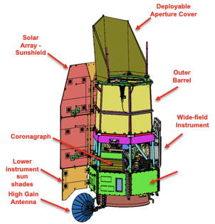

Observatory Overview
Key Features
Telescope: 2.4m aperture
Instruments:
  Wide Field Imager / Slitless Spectrometer
  Internal Coronagraph
Data Downlink: 250-500 Mbps
Data Volume: 11 Tb/day
Orbit: Sun-Earth L2
Launch Vehicle: 3 options
Mission Duration: 5 yr, 10yr goal
Serviceability: Observatory designed to be robotically refuelable

Slide 4
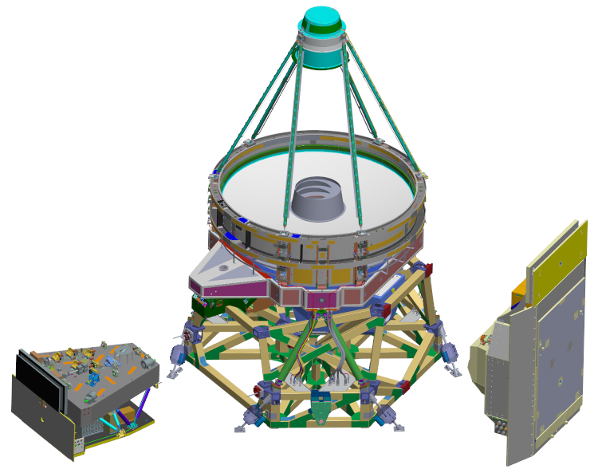
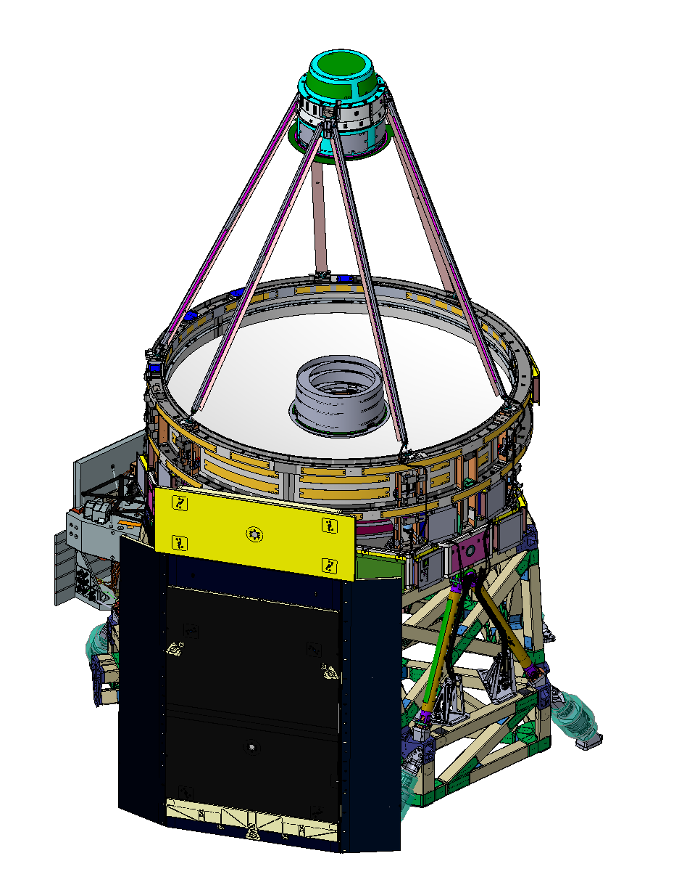
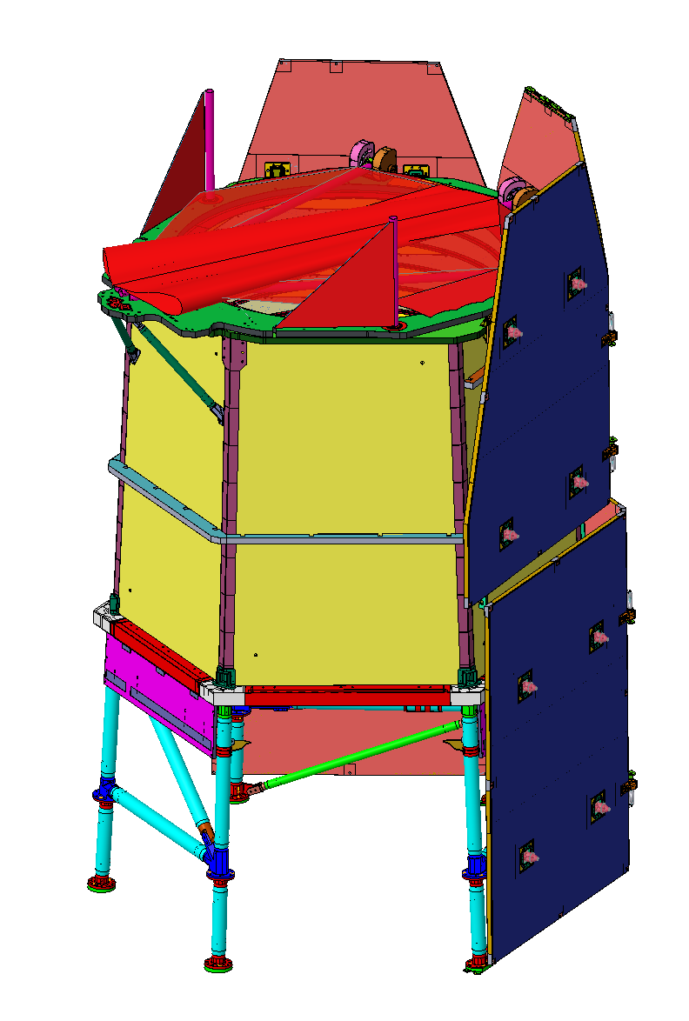
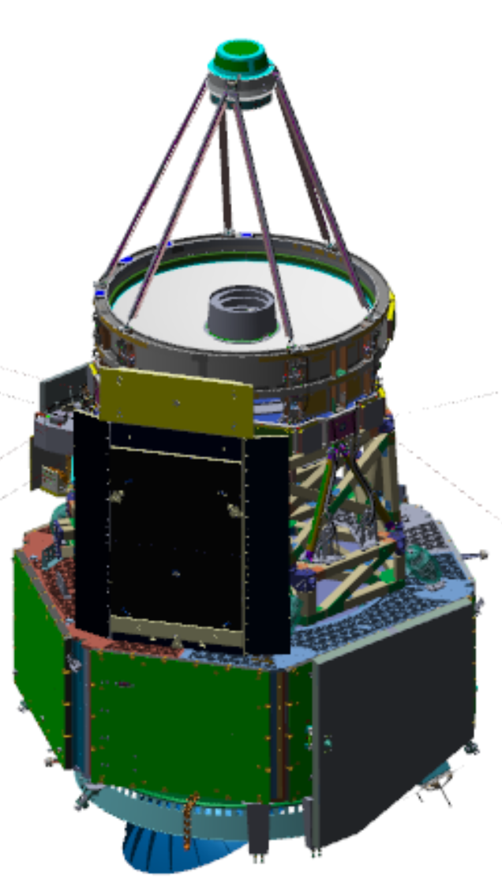
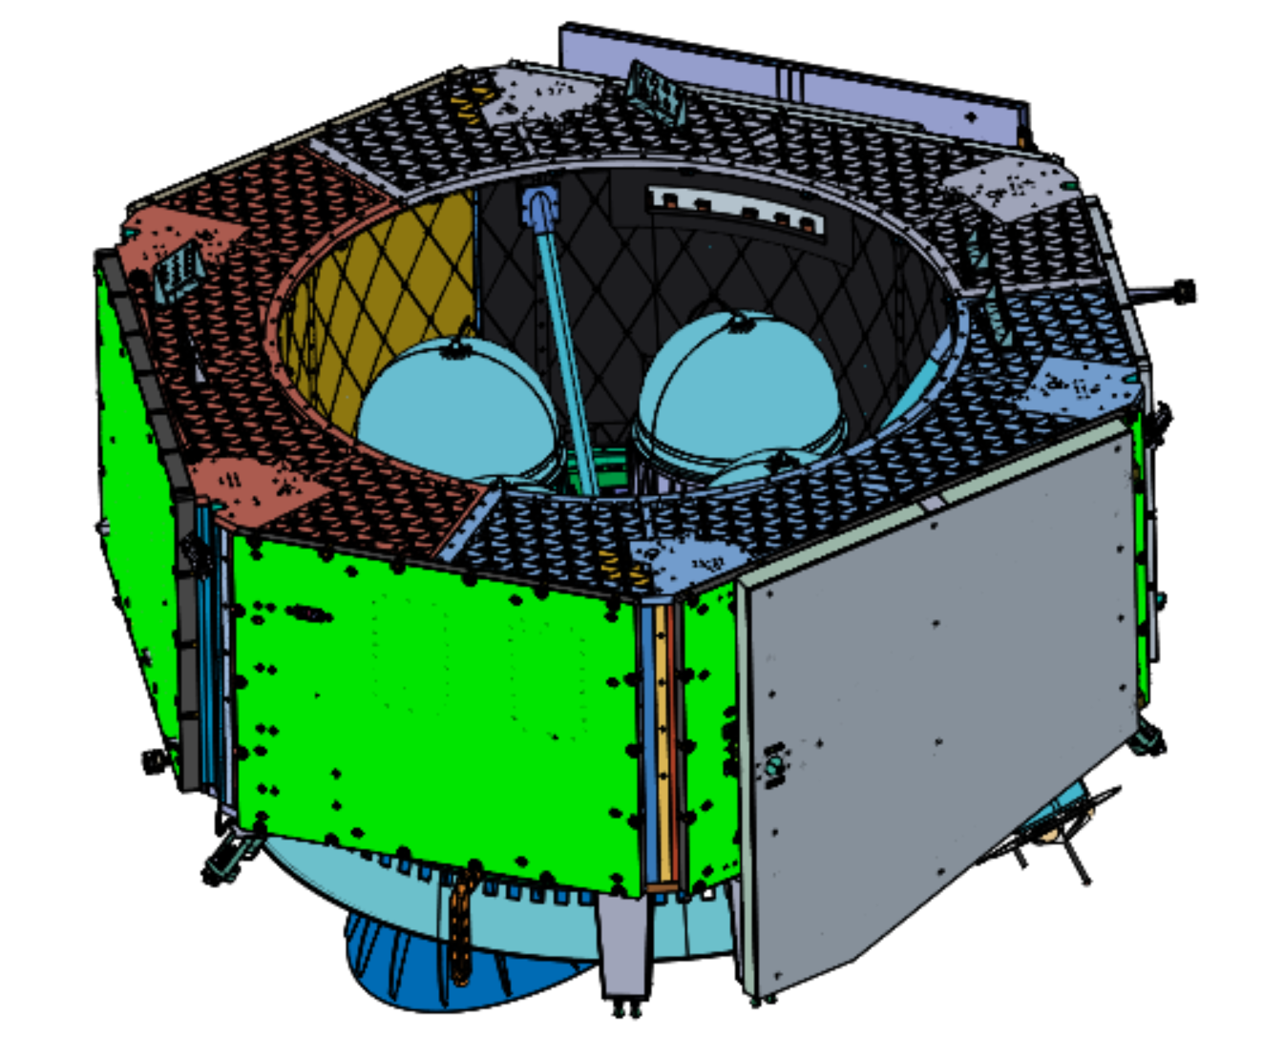
Observatory Expanded View
Observatory = Spacecraft + Integrated Payload Assembly
Imaging Optics Assembly
Deployable Aperture Cover (DAC)
Solar Array
Sun Shield (SASS)
Integrated Payload
Assembly
Coronagraph
Instrument (CGI)
(outer enclosure
not shown)
Wide Field
Instrument (WFI)
Outer Barrel
Assembly (OBA)
Instrument
Carrier (IC)
Spacecraft Bus Avionics Panels
Propulsion Module
Spacecraft Bus
Communications
Module

Slide 5
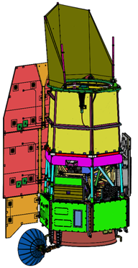
System Architecture Diagram
Flight Dynamics Operations Area (FDOA)
SN (Launch Support):
S-Band (CMD/TLM)
Acquisition and Tracking Data
Maneuver Plans, Products
NEN: S-Band (CMD/TLM/TRK); Ka-Band (SCI)
ESA-New Norcia: Ka-Band (SCI)
JAXA-GREAT: Ka-Band (SCI)
DSN: S-Band (CMD/TLM/TRK)
HK Telemetry
Mission Operations
Center (MOC)
Observatory Commands
DAPHNE
Science Data Files
Science Users & Community
SITs, Public
GO/GI, PSP
Science Operations Center (SOC)
WFI & SOSE Data Products
Observations,
Data Products
Planning & Scheduling Products
Archive
Observation Planning,
Data Products
Observations,
Data Products, Proposals
Science Support Center (SSC)
CGI HK Data
CGI Commands & Products
Coronagraph Technology Center (CTC)
CGI Observations,
Data Products
CMD – Command; TLM – Telemetry; TRK – Tracking; HK – Housekeeping; SCI – Science

Slide 6
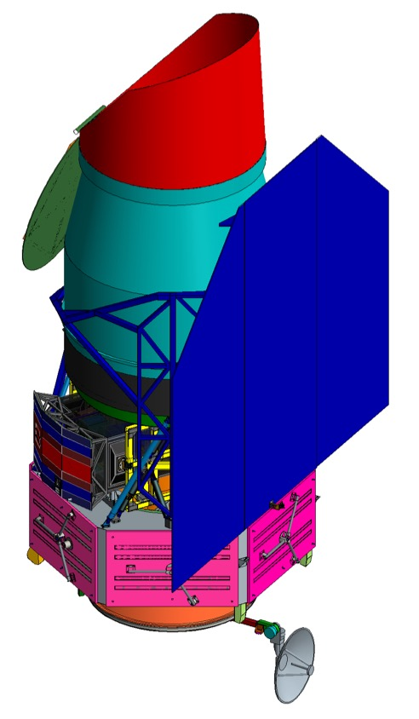
Field of Regard
Observing Zone:
54˚-126˚ Pitch off SunLine
360˚ Yaw about Sun Line
±15˚ Roll about Line of Sight (LOS) off max power roll angle
SNe Fixed Fields ±20˚ off the Ecliptic Poles
SNe Fields
Earth/Moon LOS avoidance angles are a minor sporadic constraint
+54˚
+126˚
Galactic Bulge (Available twice yearly)
Keep-Out
Zone
Keep-Out
Zone
GB
HL/GO/Coronagraph Surveys can be optimized within the full Observing Zone
Microlensing can observe Inertially Fixed Fields in the Galactic Bulge (GB) for 72 days twice a year
Observing Zone
SNe Fields

Slide 7
Payload Optical Block Diagram

Slide 8
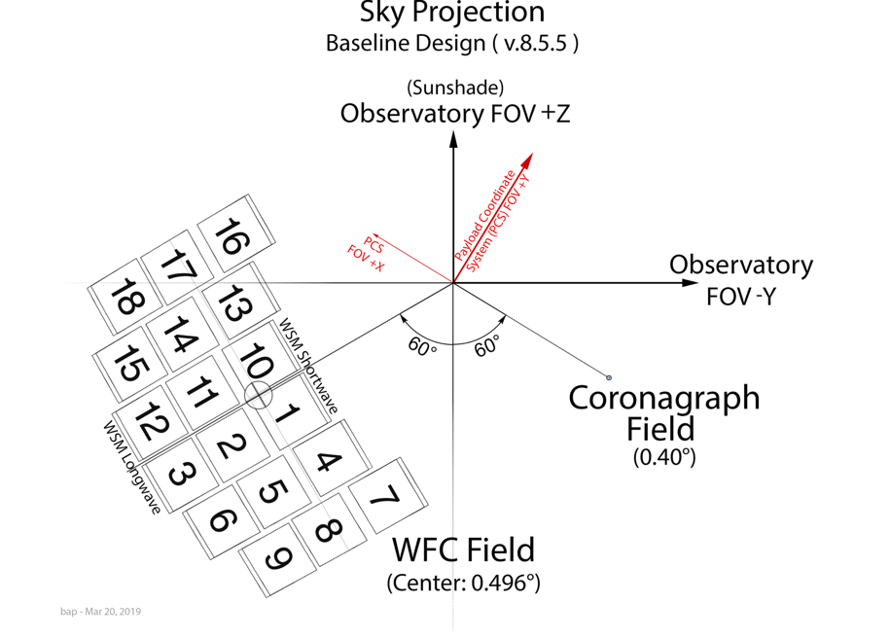
Optical Field Layout

Slide 9
Representative Slew Times
Times computed assuming maximum expected inertia.
Times shown include the settle time.
Baseline operations:
6 wheels
Must meet mission requirements with 5 wheels
Slew type | Slew angle (deg) | Slew time (s) 6 wheels | Slew time (s) 5 wheels
Gap Fill | 0.025 | 21.4 | 23.4
Short FoV | 0.4 | 49.3 | 54.8
Long FoV | 0.8 | 67.4 | 76.0
2-deg | 2.0 | 98.7 | 116
5-deg | 5.0 | 162 | 179
10-deg | 10.0 | 267 | 284
30-deg | 30.0 | 667 | 684
90-deg | 90.0 | 1865 | 1882

Slide 10
Slew and settle times

